Slide 1
COLORADO ACCESS
Region 5 Program Improvement Advisory Committee
December 17, 2018

Slide 2
Welcome & Introductions Robert Bremer Vice President of Integration Colorado Access

Slide 3
Today’s Agenda
4:00 | Dinner, Welcome and Introductions
4:15 | Review of Today’s Agenda
4:20 | Review of Committee Tasks – Digging Deeper
5:00 | Discussion regarding Development of a Committee Onboarding/Education Plan
5:20 | Discussion regarding Committee Structure and Logistics
5:50 | Public Comment
6:00 | Meeting Adjourned

Slide 4
Digging Deeper on Committee Responsibilities/Tasks Kelly Marshall Director of Community & External Relations Colorado Access

Slide 5
Regional PIACs – Purpose
To engage stakeholders and provide guidance on how to improve health, access, cost, and satisfaction of Members and providers in the Program.
(Base Contract Section 16.9.2, pg. 109-110)

Slide 6
Regional PIAC – Contractual Responsibilities
Provide representatives for the statewide PIAC
Review Member materials and provide feedback
Review the Contractor’s (Colorado Access) deliverables
Discuss program policy changes and provide feedback
Review the Contractor’s (Colorado Access) and Program’s performance data
(Base Contract Section 16.9.2, pg. 109-110)

Slide 7
1. Provide representatives for Statewide PIAC
The State PIAC is made up of stakeholders who provide guidance and make recommendations to help improve health, access, cost and satisfaction of members and providers in the Accountable Care Collaborative.
Subcommittees:
Improving and Bridging Systems
Health Impact on Lives: Health Improvement
Provider and Community Issues
Notes:
Reference membership directory handout
Reference request from HCPF to regional appointees to give a 5-10 minute update at their January retreat

Slide 8
2. Review Member materials and provide feedback
Colorado Access Member Advisory Council
The purpose of the Member Advisory Council is to ensure that members, their family members, and caregivers have a voice in the projects and programs at Colorado Access which impact all members. Our council members represent a variety of communities and provide valuable insight into how Colorado Access may best serve its members.
Member Advisory Council Charter (approved 2/20/18)
Notes:
As a result of the Person- and Family-Centered Care Implementation Grant in 2012, HCPF began their journey to implement a process that involved clients and families in the development and feedback of building programs and initiatives.
They also established a group of internal staff as Champions to incorporate those values throughout HCPF.
We have a strong history of

Slide 9
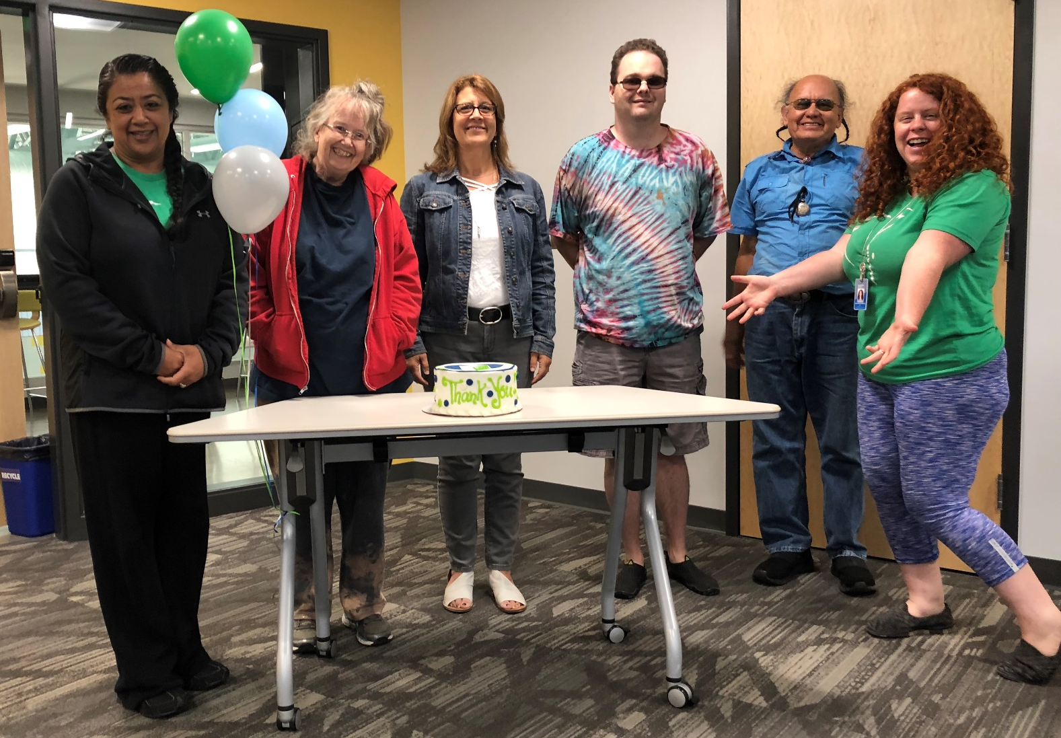
MAC One Year Anniversary in August 2018
Notes:
Introduce themselves along with the “membership/community” they represent.

Slide 10
2. Review Member materials and provide feedback
Recommendation for establishing a formal relationship between the Member Advisory Council and this Committee
At least one formal member in common
Access to each other’s meeting agendas, minutes and other meeting materials
MAC meetings open to PIAC members with an RSVP (MAC meetings are not open to the public)
PIAC can make a request of MAC for feedback/input on a particular program/issue.
PIAC can request updates on MAC work for reporting purposes.

Slide 11
3. Review the Contractor’s Deliverables
Overview
67 deliverables of varying frequency and magnitude.
40 notifications
Before the start of the contract (July 1), Colorado Access submitted 25 start-up deliverables.
Since ‘go live’ (July 1) 40 deliverables have been submitted.
Typically it takes the State 45 days to provide feedback. Most of these have been accepted or accepted with request for additional information.
Report templates for several of the deliverables are still being developed and tweaked by the State.
Notes:
Walk through handout with descriptions of all 67 deliverables.
We did not include notifications for obvious reasons.

Slide 12
3. Review the Contractor’s Deliverables
How to prioritize?
How to make this meaningful for YOU, for Colorado Access and for the State?
Some ideas…
Base Contract:
#15. Health Neighborhood and Community Report
#16. Member Engagement Report
#21. Care Coordination
#26. Population Health Management and Stratification Report
Colorado Access Specific:
Comprehensive Community Needs Assessment
Comprehensive Community Engagement Plan

Slide 13
Today’s Agenda
4:00 | Dinner, Welcome and Introductions
4:15 | Review of Today’s Agenda
4:20 | Review of Committee Tasks – Digging Deeper
5:00 | Discussion regarding Development of a Committee Onboarding/Education Plan
5:20 | Discussion regarding Committee Structure and Logistics
5:50 | Public Comment
6:00 | Meeting Adjourned

Slide 14
Potential Educational Topics
In no particular order…
Attribution / Provider Assignment
Pay for Performance Measures
Population Health Management
Care Management / Care Coordination
Member Engagement activities
Provider Relations & Engagement activities
Colorado Access, the organization
Colorado Health Care Policy and Financing (HCPF) and the Health First Colorado Program (Medicaid)
State Program Improvement Advisory Committee and subcommittees
Collective Impact – the application of this methodology to our work
Notes:
Not in any particular order
2-3 educational topics to make your participation fruitful?
1-2 barriers to your full engagement that we should know about/take into account?

Slide 15
Today’s Agenda
4:00 | Dinner, Welcome and Introductions
4:15 | Review of Today’s Agenda
4:20 | Review of Committee Tasks – Digging Deeper
5:00 | Discussion regarding Development of a Committee Onboarding/Education Plan
5:20 | Discussion regarding Committee Structure and Logistics
5:50 | Public Comment
6:00 | Meeting Adjourned

Slide 16
Meeting Structure and Cadence
Ideas for Feedback:
Quarterly for two hours, with sub-committee/workgroup options in between meetings
Quarterly with a longer meeting time.
Bi-monthly
Monthly

Slide 17
Region 5 PIAC – Upcoming action items
Next meeting:
Leadership Selection: Committee co-chairs
Charter development: Recommend the creation of a workgroup to draft a charter for committee adoption. Volunteers?!
By end of year 1 (June 30, 2019):
Elect two representatives to sit on the Region 5 Governing Council.
Select State PIAC representative from this Committee.

Slide 18
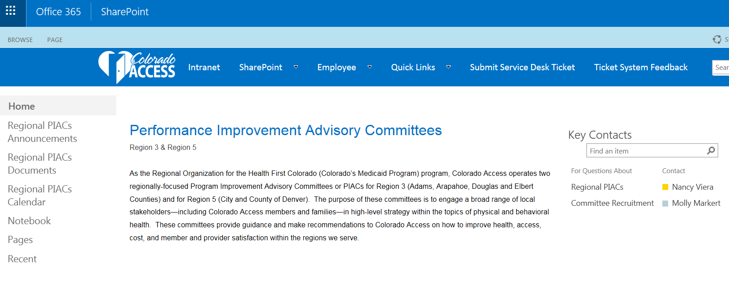
Sharepoint

Slide 19
Public Comment, Questions and Open Discussion

