Slide 1
REGION 5 PERFORMANCE IMPROVEMENT ADVISORY COMMITTEE
Monday, June 10, 2019
Colorado Access

Slide 2
Committee Business
Approval of March meeting minutes
Approval of Committee Charter
Approval of Leadership Positions
Selection of staggered terms
Member Advisory Council visit schedule update

Slide 3
Leadership Proposal for Consideration and Approval
Chair: Judy Shlay, Denver Public Health
Vice Chair: Jacquie Stanton, Denver Public Schools, Community Association of Black Social Workers
Member Chair and Liaison to the Member Advisory Council: Laurie Gaynor, Health First Colorado
Region 5 Governing Council Representative #1: Sue Williamson, Colorado Children’s Healthcare Access Program
Region 5 Governing Council Representative #2: Karen Weber, SCL Health, Caritas Clinic at St Joseph Hospital
State PIAC Representative: Dede De Percin, Mile High Health Alliance

Slide 4
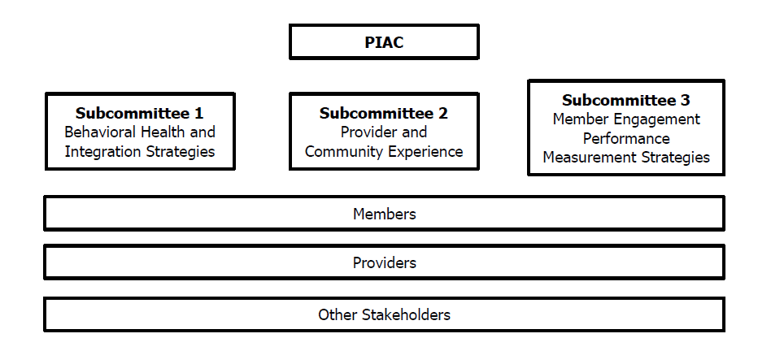
State PIAC Update

Slide 5
REGIONAL PERFORMANCE –
PHYSICAL HEALTH CONCEPTUAL OVERVIEW
PAY FOR PERFORMANCE – PHYSICAL HEALTH
Catherine Morrisey and Kelly Marshall

Slide 6
AGENDA
Enrollment and Demographics
Physical Health Measures (5 out of 7)
  Current Performance
  Current Intervention Planning
Feedback and Discussion

Slide 7

Region 5 Current Enrollment = 198,691 Lives*
(as of Feb 28, 2019)
Demographics
* 77,337 lives attributed to Denver Health plan for physical health
Majority of members identify as non-white
51.8% identify as female
(As of Dec 31, 2018)

Slide 8
Pay for Performance Measures
PHYSICAL HEALTH
Dental visits
Wellness visits
Prenatal engagement
Emergency Department (ED) Utilization
Health Neighborhood
Potentially Avoidable Costs
Behavioral health engagement
BEHAVIORAL HEALTH
Engagement in Substance Use Disorder (SUD) Treatment
7-Day Follow-Up After Inpatient Discharge for Mental Health
7-day Follow-Up After ED Visit for SUD
Follow-Up After a Positive Depression Screen
Behavioral Health Screen/Assessment for Foster Care Members
Today

Slide 9
Physical Health Pay for Performance Measures
SFY1819 Performance
Q1 Regional Comparison for Payout

Slide 10
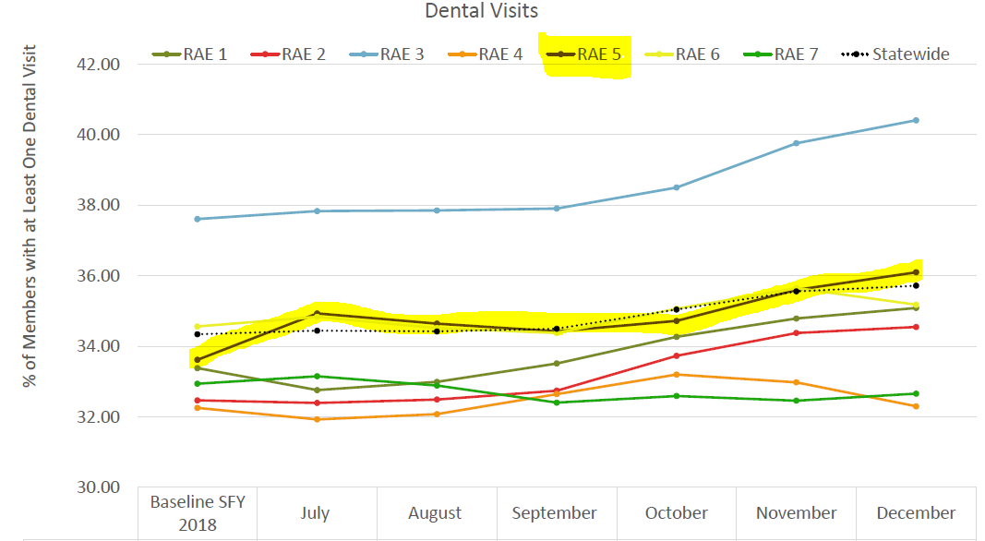
Dental Visits: Percent of distinct count of members who received professional dental services. This includes dental services from both medical and dental claims.

Slide 11
Intervention Planning Work with CCHAP/Dental
Contract with Colorado Children's Health Access Plan (CCHAP)
Increasing dental services within pediatric practices
  Focus is on getting pediatric practices “live” on Cavity Free at 3
  Currently engaged with 36 practices in RAE 3 and 5
  Now actively engaged 10 practices based that are in different stages of training to implementation

Slide 12
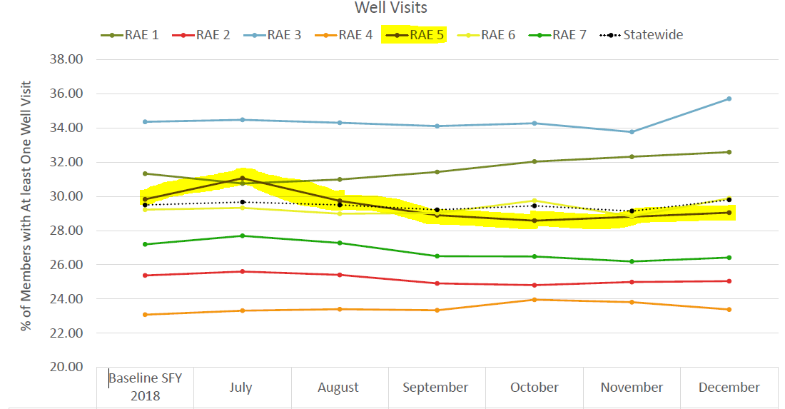
Well Visits: Percent of distinct members who received a well visit within the 12-month evaluation period

Slide 13
Interventions In-Progress: Well Visits
  Focus is on getting practices access to and comfortable with using data (State’s Data Analytics Portal ‘the DAP’)
    Development of member outreach cross-walking different data sets and reports for phone number and addresses
    Practices need the data to be able to do outreach
  Sequential scheduling of dental/well visits for integrated sites
  Alignment of Performance Improvement Projects (PIP) for members ages 10-14
    Providers include Stride Health and Bruner.

Slide 14
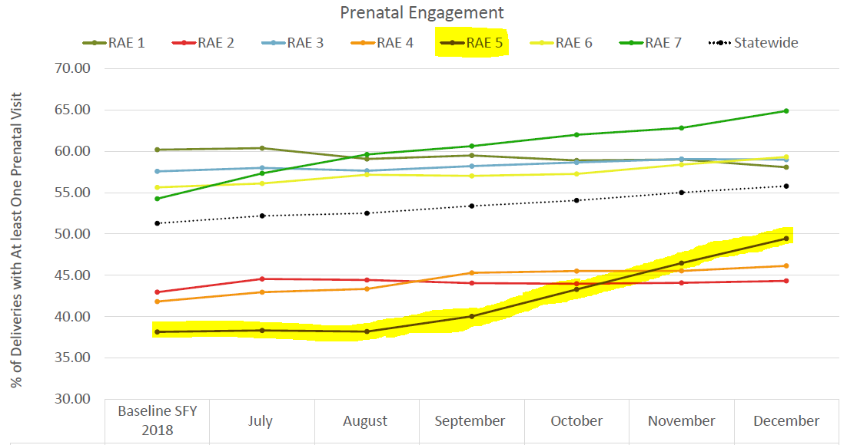
Prenatal Engagement: Percent of members who received a prenatal visit during pregnancy.

Slide 15
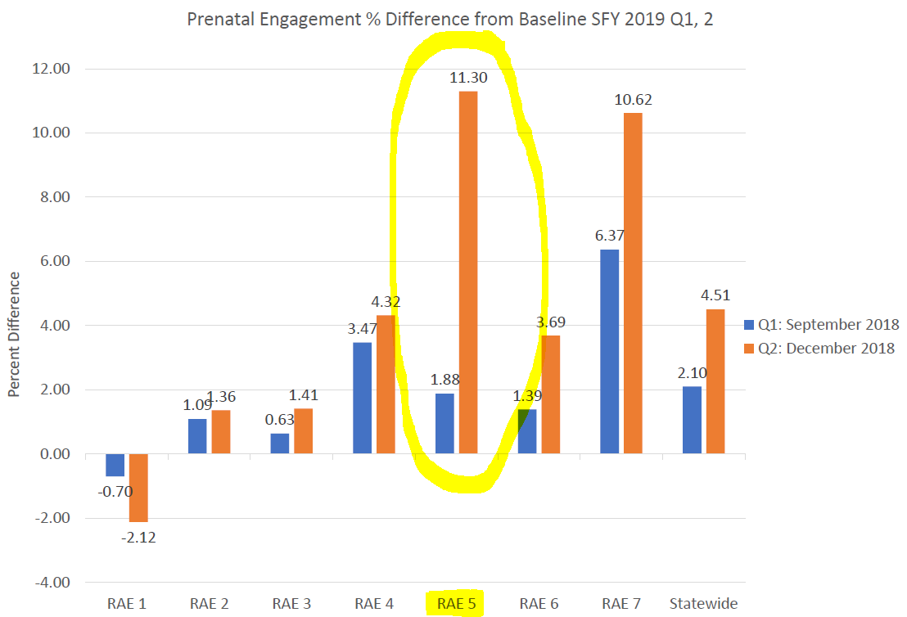
Prenatal Engagement: Percent of members who received a prenatal visit during pregnancy.

Slide 16
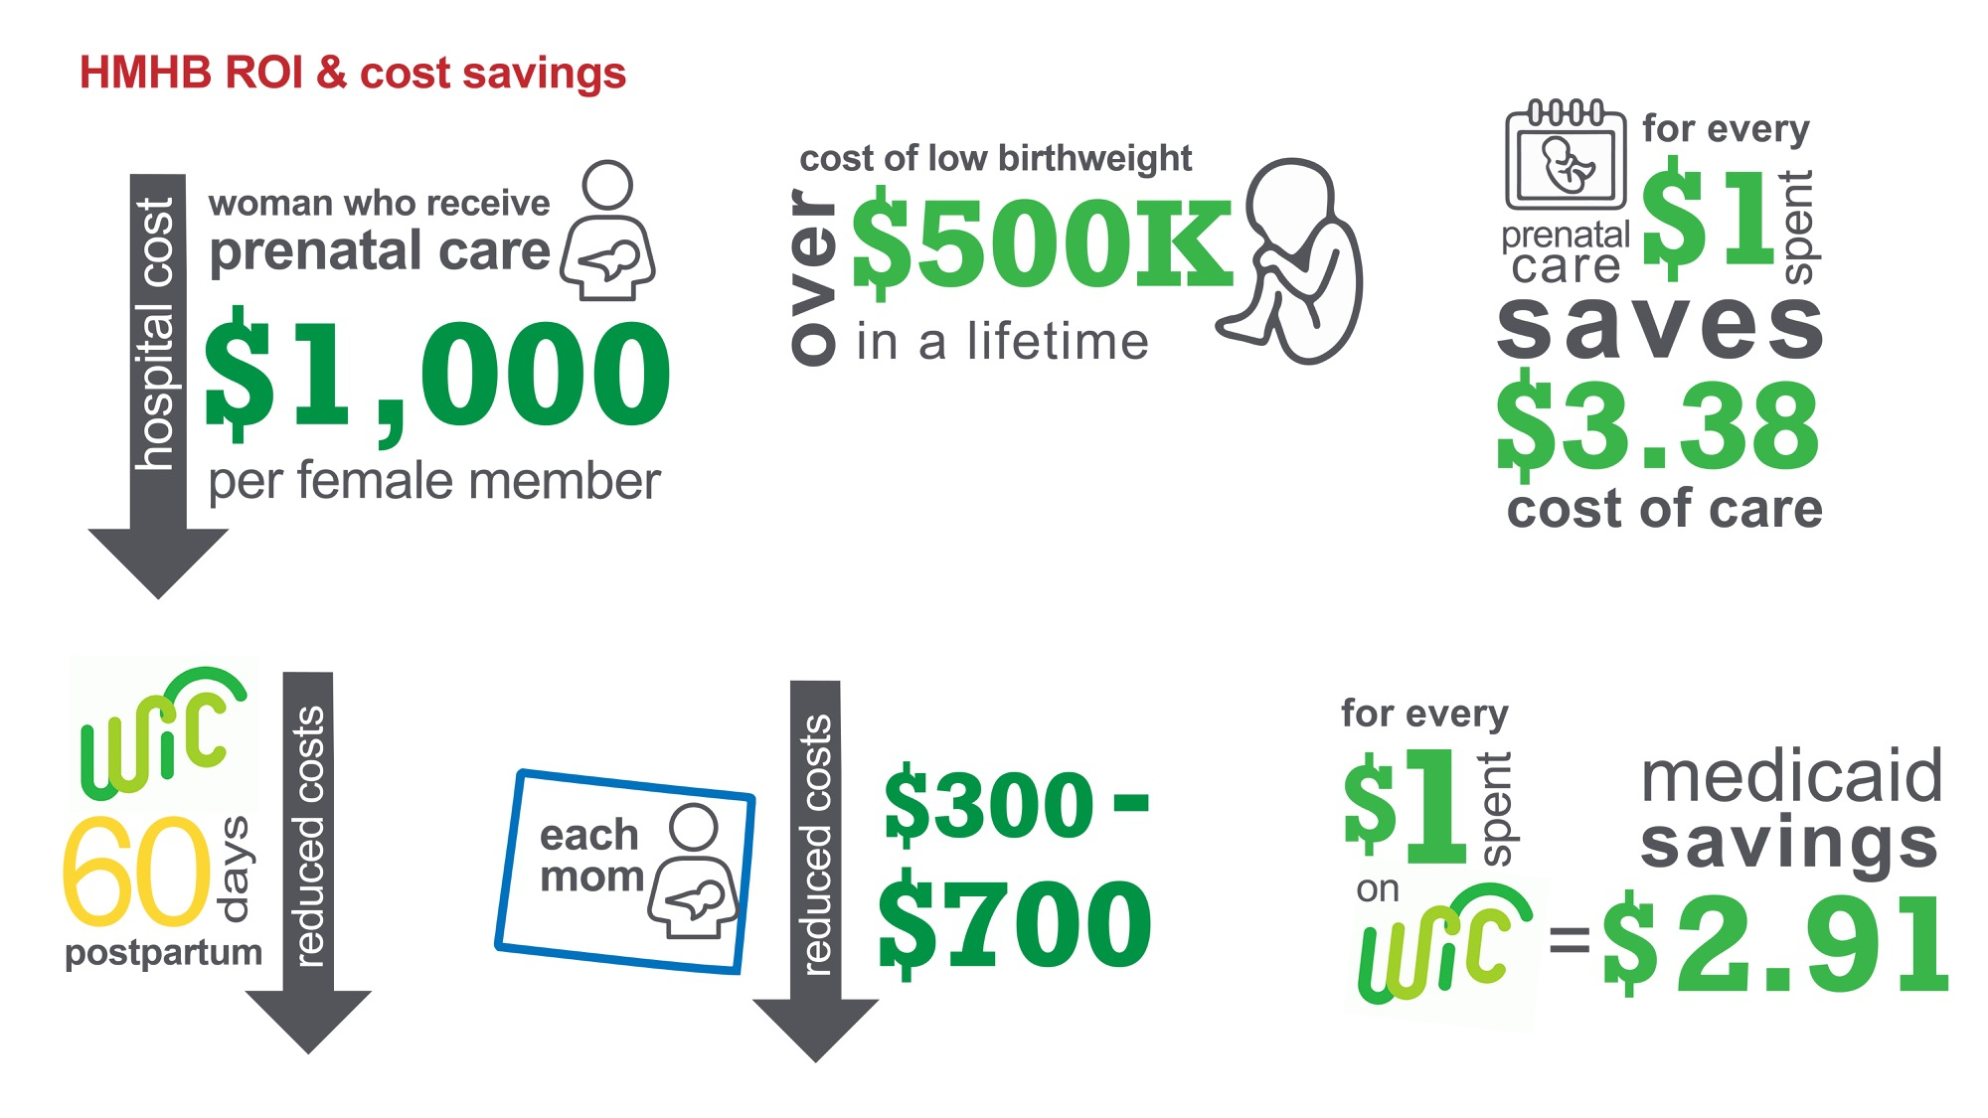

PERINATAL WOMEN: A KEY OPPORTUNITY
Notes:
COA’s HMHB program focuses on the following key objectives:
Timely access to, and continued participation in, prenatal care.
For mom:
Women who do not receive adequate prenatal care cost more to the healthcare system. Through engaging members in receiving, and sustaining, prenatal care, COA is supporting a decreased hospital costs of over $1,000 per female member. (1)
For baby:
Women who do not receive adequate prenatal care are at a higher risk for having a low birth weight baby. These babies are costly within the healthcare system, with The National Commission to Prevent Infant Mortality estimating the cost of a low birthweight infant to be over $500,000 during their lifetime. (1)
It is estimated that for every dollar spent on prenatal care, $3.38 is saved in the cost of caring for low-birth-weight infants. (1)
Engagement with WIC and Baby and Me Tobacco Free
WIC has been shown to support mom and baby health outcomes, including low birth weight, through nutritional support, education, peer counseling and social support. It is estimated that a reduction in Medicaid costs occur the first 60 days postpartum if mom and baby are enrolled in WIC. Estimates at the state level are between $300-$700 per mom. (2)
Women who received Medicaid benefits and prenatal WIC services had substantially lower rates of low and very low birth weight than did women who received Medicaid but not prenatal WIC. Among white women, the rate of low birth weight was 22% lower for WIC participants and the rate of very low birth weight was 44% lower; among black women, these rates were 31% and 57% lower, respectively, for the WIC participants. Prenatal participation in a WIC program reduces the rate of low birth weight. It was estimated that for each $1.00 spent on WIC services, Medicaid savings in costs for newborn medical care were $2.91. A higher level of WIC participation was associated with better birth outcomes and lower costs.
COA is focused on partnering with WIC to improve enrollment rates during the prenatal period, as it increases the likelihood of a sustained connection immediately post delivery.
Henderson, J.W. (1994). The Cost Effectiveness of Prenatal Care. Health Care Finance Rev, 15(4), 21-32. Retrieved from https://www.ncbi.nlm.nih.gov/pmc/articles/PMC4193436/.
2. The Savings in Medicaid Costs for Newborns and their Mothers Resulting from Prenatal Participation in the WIC Program. (1990, October 1). Retrieved from https://www.fns.usda.gov/wic/savings-medicaid-costs-newborns-and-their-mothers-resulting-prenatal-participation-wic-program.
3. North Carolina. J Am Diet Assoc, 93(2), 163-6. Retrieved from https://www.ncbi.nlm.nih.gov/pubmed/8423280.

Slide 17
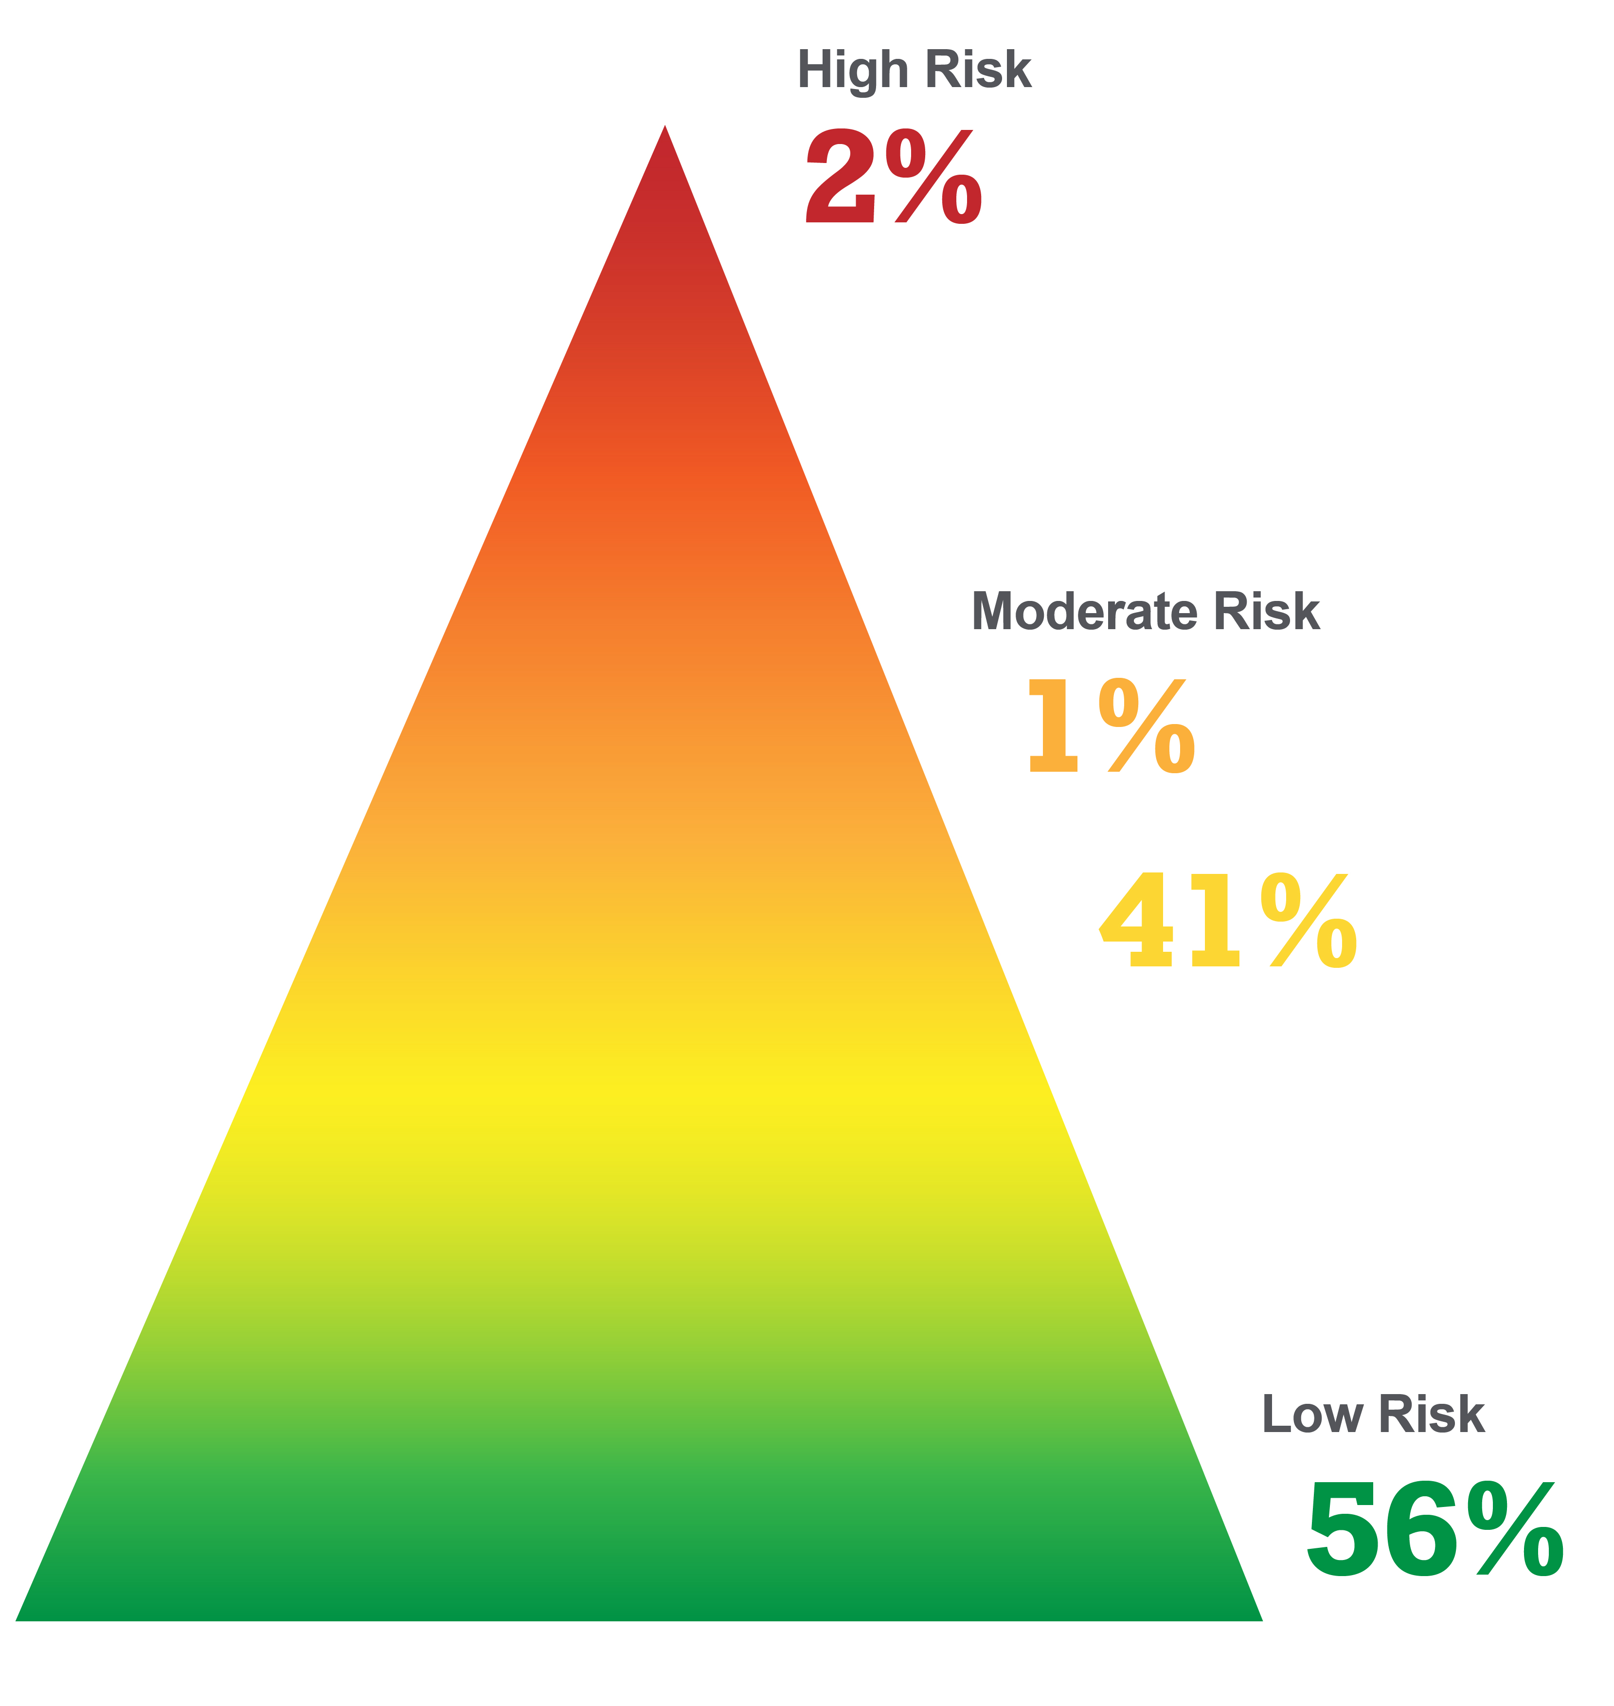
HEALTHY MOM, HEALTHY BABY
How Members are Identified
Monthly pregnancy registry, referrals from inpatient discharge floors, four quadrant model and supplemental data sets
Women <21 years old are referred to care management for outreach (versus digital engagement or direct mail)
Region 3 - 25% births covered by COA
Region 5 - 20% live births covered COA
Intervention Goals
Engagement in prenatal services within first trimester
Promote WIC enrollment
Prompts for pre/post natal cadence of appointments
Assessments and referrals for medical/non-medical services
Identification/intervention for behavioral health services
Extrapolated from Population Health Management Plan submitted and approved by HCPF in 10.2018.
Notes:
Additionally, members with high risk physical health indicators, which would be indicated via a higher DCG score and placement in the “high physical health” risk quadrant are prioritized for CM outreach along with digital engagement and direct mail. Members with high behavioral health risk indicators, which would be indicated via placement in the “high behavioral health” risk quadrant are prioritized for CM outreach along with digital engagement and direct mail. Care Managers first and foremost identify if women are already tucked into care with appropriate coordination at the clinic level to avoid duplication of services.
On HMHB pop strat grid, just use the adult percents for the distribution, as the peds numbers are quite small and a weighted % would work out to the adult #s.

Slide 18
HEALTHY MOM, HEALTHY BABY ENGAGEMENT RESULTS
Engagement Results
All pregnant women enrolled (approx. 650 newly pregnant women/month)
95% receive technologically based perinatal-specific interventions
  Interactive voice response (98% completion rate)
  Text-based programming (100% completion rate)
  5% receive individual, intensive care coordination
  Age 21 or younger
  High behavioral health and/or physical health need (4-quadrant model)
Program Outcomes
  WIC and Baby and Me Tobacco Free enrollment
  Breastfeeding, tobacco cessation and peer support
    Support family planning in place at time of delivery—follow Colorado’s Family Planning Initiative
  LARC-focused interventions screening for and intervening in pregnancy-related depression
Notes:
COA’s HMHB program focuses on the following key objectives:
Supporting members in identifying the right family planning option to fit their needs.
Through the HMHB program, COA supports members in working with their prenatal/primary care provider in identifying the right type of family planning support needed upon delivery. This is used to ensure appropriate birth spacing (supports healthy pregnancies and birth outcomes), as well as ensuring the member is ready for a subsequent child. COA seeks to follow the statewide Family Planning Initiative work, which has demonstrated the following outcomes (1)
Teen birth rate was nearly cut in half.
Teen abortion rate was nearly cut in half.
Births to women without a high school education fell 38 percent.
Second and higher order births to teens were cut by 57 percent.
Birth rate among young women ages 20-24 was cut by 20 percent.
Average age of first birth increased by 1.2 years among all women.
Rapid repeat births declined by 12 percent among all women.
Costs avoided: $66.1-$69.6 million
Decreasing the stigma about, and ensuring appropriate access to, resources for pregnancy-related depression.

Slide 19
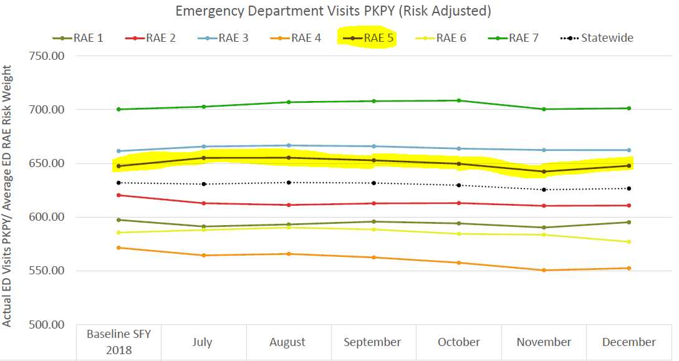
Emergency Department Visits: Number of visits for every thousand members per year.

Slide 20
Health Neighborhood Measure: Two Parts
Goal: To improve communication and coordination between primary care providers and specialists
1. Care Compact
Percentage of RAE’s primary care providers with Care Compacts (documented agreements) with specialists that outlines communication and coordination processes for shared patients.
2. Referrals
Percentage of members who had an outpatient visit with a specialist who saw a primary care provider within 60 days prior to the specialist visit and included a referring primary care provider on the claim
Notes:
Used to require Colorado Medical Society’s Primary Care-Specialty Care Compact. Now just require 4 criteria for a care compact.

Slide 21
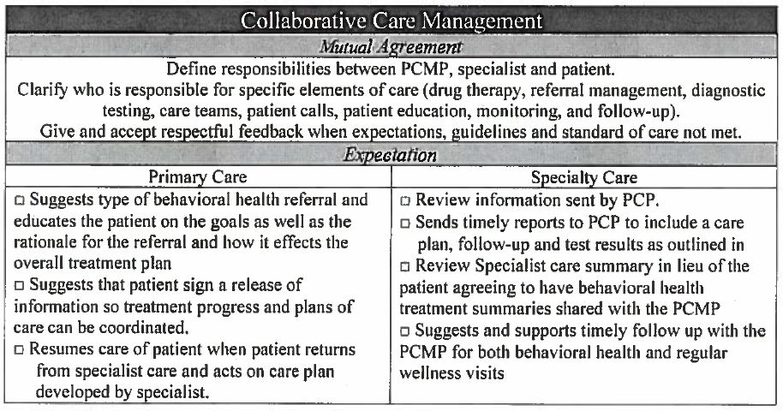
Health Neighborhood: Part 1 CARE COMPACTS
Count of Care Compacts:
Region 3 = 12
Region 5 = 48

Slide 22




Health Neighborhood: Part 2 REFERRALS
Primary Care Provider refers to specialty care
Specialist submits claim for payment
Member attends an appointment with primary
care
Member attends an out patient specialty care appointment
CALCULATION:
Denominator “Event” = Any specialty care appointment
Numerator “Event” = The Primary Care Provider appointment IF that appointment was within 60 days of the specialty care appointment AND the Primary Care Provider was listed as the referring provider on the specialty claim
Notes:
Unclear if the PCMP has to be that member’s attributed PCMP, or if it can be ANY PCMP. This was asked in the HCPF memo dated 4.23 however no response from HCPF yet.

Slide 23
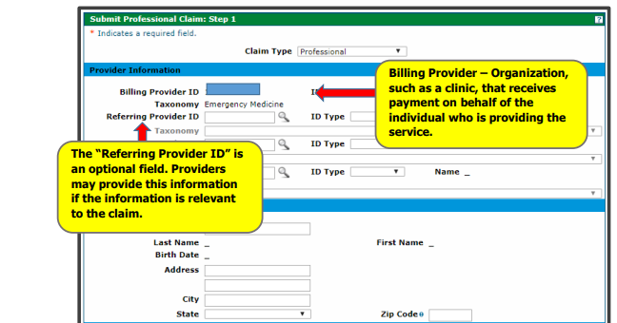
Health Neighborhood: Part 2 REFERRALS
The specialist’s claim must include the referring provider’s ID, and that provider must match a Primary Care Provider that the member saw within 60 days prior.

Slide 24
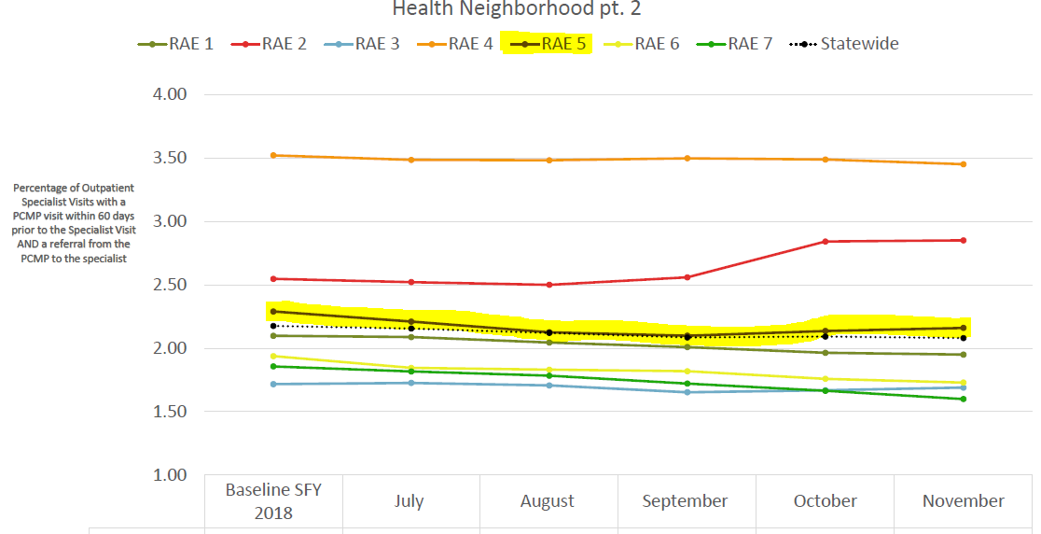

Slide 25
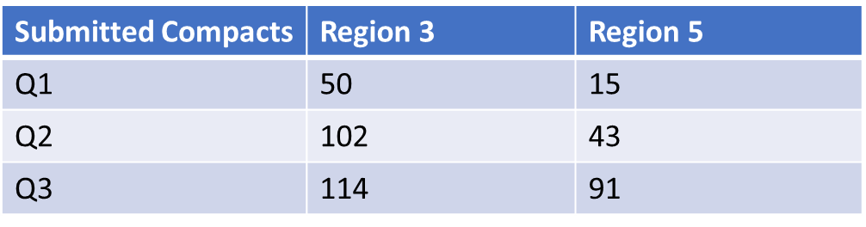
Interventions In-Progress: Health Neighborhood
Part 1 interventions – Care Compacts
  Increase was a direct result of provider assessment and outreach efforts by Practice Support team:
    Partnerships with Community Mental Health Centers
    Review and amending of existing agreements between primary and specialty care to meet State requirements
    Partnership with other RAEs to support practices and share data to meet this deliverable
Part 2 interventions – Specialty Referrals
  Denver Health/Kaiser effort

Slide 26
Collective Impact Approach
Regions 3 and 5 Governing Councils
Mutually Reinforcing Activities
Health Strategy Committee
COA Aligned Task Forces and Workgroups
Diabetes
Chronic Obstructive Pulmonary Disease (COPD)
Health Neighborhood, Part 2 (Referrals) – Coding
Wellness and Dental
Visits
Pediatric Asthma
with Hypertension and Depression/Anxiety
with Hypertension and Depression/Anxiety
with Depression /Anxiety
Potentially Avoidable Conditions Measure
Notes:
Just this month moving forward with the structure to operationalize the KPIs into the system
Model agreed upon in March by both GCs
GC HS Committee will staff support the taskforces along with COA internal topic experts
Taskforce membership will begin to allow broader participation from partners/network
Purpose is to further operationalize into the system level interventions

Slide 27
Health Strategy Committee – Membership
Member | Title/Position | Organization
Jill Atkinson | Clinical Director of Integrated Outpatient Services | Community Reach
Rachel Everhart | Director of Clinical and Operational Data Management, Analysis and Reporting-Ambulatory Care Services | Denver Health
Devra Fregin | Practice Administrator | Kids First Pediatrics
Heather Logan | Director of Accountable Care | Stride Health
Carlos Madrid | Senior Manager, Medicaid Clinical Operations | Kaiser
Justin Wheeler | VP of Clinical Services | Clinica
Wes Williams | Vice President and Chief Information Officer | Mental Health Center of Denver
Chase Gray | Senior Director of Health Services | Colorado Access
Krista Beckwith | Senior Director of Population Health, Quality & Evaluation | Colorado Access
Kim Nordstrom | Medical Director, Behavioral Health | Colorado Access
Kelly Marshall | Director of Community & External Relations | Colorado Access
Notes:
Reminder of who currently sits on committee

Slide 28
Evolution of Regional Involvement
Community Support and Collaboration
Broader Provider Network Inclusion
Core
Taskforces
Notes:
More work needs to be done in this concept
How to continue with designing the broad community/collective impact model in relation to the KPI topics
Initiate work via taskforces without a perfect model…spirit that we need to initiate something/for some purspose.

Slide 29
Discussion and Feedback
Q&A for understanding
General feedback on the measures
Collecting information about related efforts and potential collaborations

Slide 30
REGIONAL PERFORMANCE –
PHYSICAL HEALTH CONCEPTUAL OVERVIEW
PRIMARY CARE PROVIDER NETWORK PERFORMANCE
Kelly Marshall

Slide 31
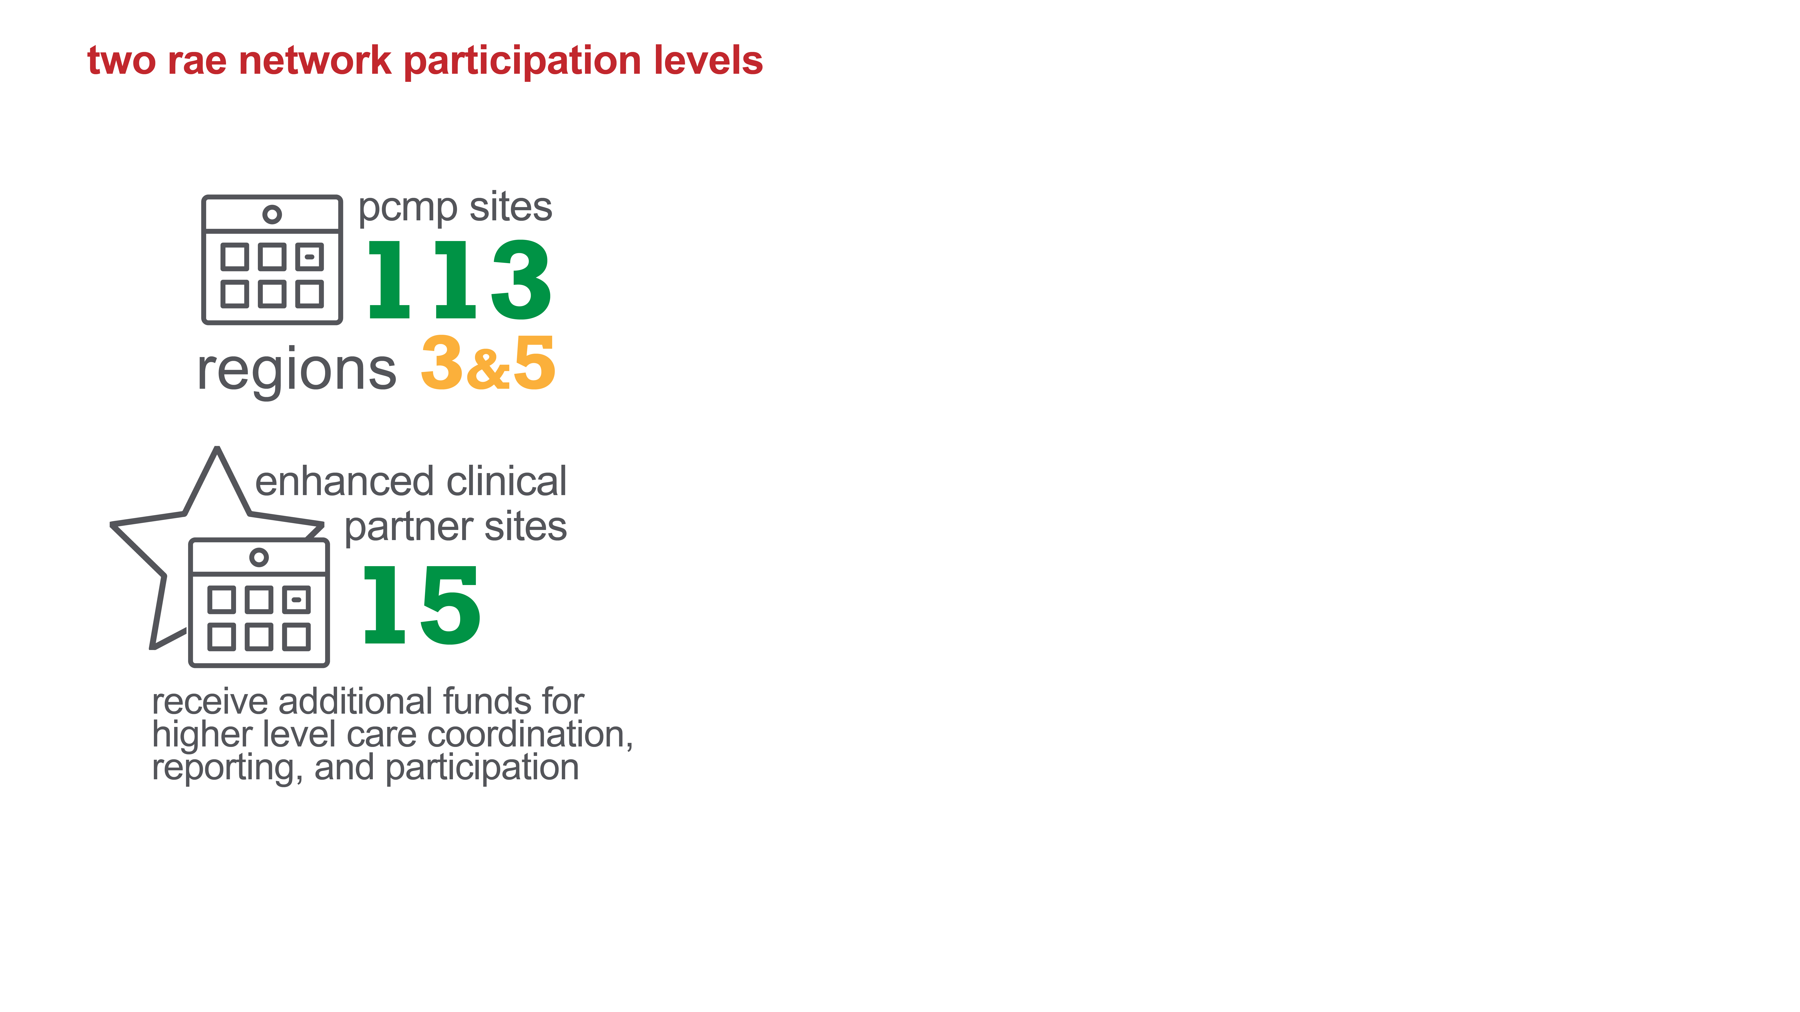
COA’s Provider Network for Region 3 & Region 5

Slide 32
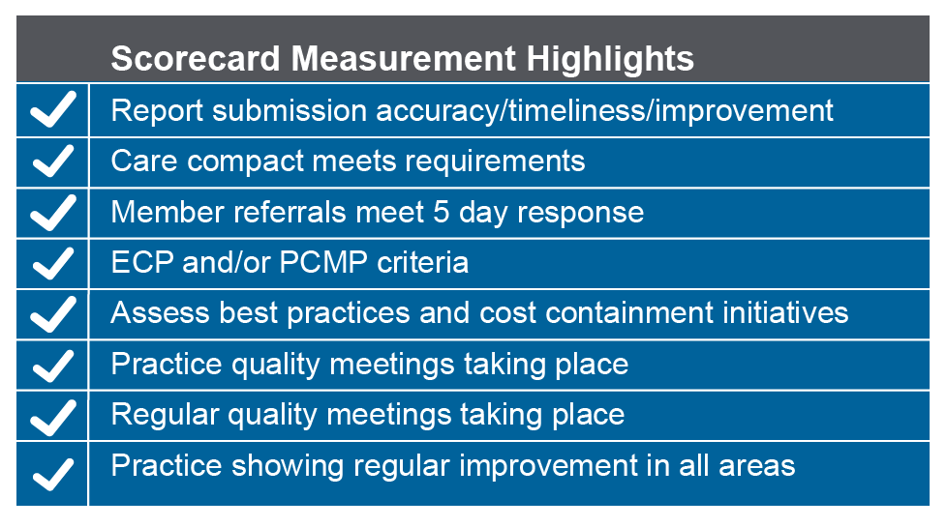
PRACTICE PERFORMANCE SCORECARD (SFY 2018-19)
Notes:
PCMP & ECP Scorecard Rating
Cadence: ECP assessed quarterly; PCMPs assessed twice annually
Scorecard Measurements highlights:
Report submission accuracy, timeliness, improvement quarter over quarter
Care Compact meets requirements
Member referrals meet 5 day response
Consistently meets ECP minimum criteria
Consistently meets Medical Home criteria
Practice appropriately staffed
Regular quality meetings taking place
Practice is showing regular improvement in all areas of expectations
Scorecard outcomes will be used to assess the level in which providers qualify for incentive and/or ECP payments.

Slide 33
VALUE-BASED PAYMENT DRAFT FRAMEWORK/PHILOSOPHY

