Slide 1
Potentially Avoidable Costs/Complications - PAC
Sarah Lambie
Quality Improvement Program Manager at Colorado Access
Notes:
25 minutes total with Q&A. Present for 15.
Hello and welcome. Today we will be discussing another one of Colorado Access’ key performance measures: PAC, which stands for potentially avoidable costs/complications.
Ask by show of hands how many people were able to watch the online learning course on PAC?

Slide 2
Discussion Questions (after presentation)
For future report-outs, what would you like to know more about and in what format? (More data? More information about clinical programming interventions?)
Are you aware of programs in the community related to these PAC priorities that Colorado Access should be aware of and learn more about?
What do you think Colorado Access and regional partners can do to have the most impact?
Is there anything you think is missing from this conversation that would make a significant difference?
Notes:
Are you aware of other diabetes, asthma, and substance abuse disorder activities that we should be looking into (gaps)?
Is there anything that surprised you about what avoidable costs were identified? Was there anything that you thought was missing?
What excites you about this work? Where do you think COA and the PIAC can have the most impact?
What would you like to know more about and in what format? Even for a future presentation – More data? More clinical interventions? Semi-annual report with tiers achieved per P4P measure?

Slide 3
What is the purpose of PAC?
PAC aims to target the high cost services that are avoidable.
Other Pay for Performance measures focus on increasing member well visits, and dental visits, as well as referrals to appropriate follow-up care.
Notes:
Previously Catherine Morrissey presented the other performance measures listed on this slide, and today we will be going into more detail about the 6th physical health measure, potentially avoidable costs.
Before we jump into the specifics of COA’s PAC project, let’s run through the PAC project in general.
Other Pay for Performance measures focus on increasing compliance with member well visits, dental visits, and referrals to mental health care as appropriate aim to target preventative care.
PAC aims to target the high cost services that are avoidable.
How do we determine what is avoidable?

Slide 4
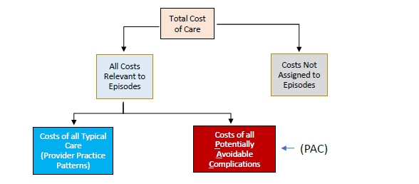
PAC Definition
Notes:
***DESCRIBE THE DIAGRAM
The PAC performance measure definition and data were released by the State in December 2018. As a newer measure compared to other P4P metrics, the State is approaching this project differently and has partnered with an external data analytics and research firm “PROMETHEUS”, also known as Altarum or Optumas .
They gathered data and diagnosis information to form a methodology about what health care costs are “typical” and which are considered “complications”.
To summarize, if we look at the health care system at a higher level we have a total cost of care for all treatment provided. The PROMETHEUS methodology can be applied to a wide variety of diagnoses within the categories listed on the previous slide. If there is a cost for a service that does not fit into a PAC episode, then this information is set aside. PAC only looks at episodes currently identified by PROMETHEUS at this time. These relevant episode costs are then further broken down into whether or not the cost was typical or avoidable.
The PROMETHEUS data allows Colorado Access to sort by high cost episodes and services to target where additional supports and interventions are needed in order to drive down avoidable services and subsequent costs. Ultimately, PAC work will help to reduce unnecessary spending within the Medicaid system.
So what are these episodes?

Slide 5
PAC Dashboard: Episode Types
Chronic
Asthma, Diabetes, Mental Illness, Substance Use Disorder
System Related Failure
Routine sick care, Pancreatitis, Sepsis
Other
Pregnancy, Newborn, Hepatitis C
Procedural
Tonsillectomy, Gall Bladder Surgery, Colonoscopy
Acute
Stroke, Pneumonia, Upper Respiratory Infection
Notes:
To further analyze the episodes, there are 5 major categories.
Examples of PAC Episode Types:
Chronic conditions are long-lasting in effects, or a disease that comes “with time”: Asthma (EX), Diabetes (EX), substance use disorder, and other long term or lifelong conditions. These are the highest PAC cost episodes across both COA regions.
System related failures include Routine sick care services, Sepsis, Pancreatitis. Routine sick care, although a high cost, is made up of many small cost episodes and has not been prioritized by the State at this time for PAC work.
The most common examples of the category “Other” are Pregnancy, Newborn, and Hepatitis C. Of these examples, pregnancy is the highest cost episode across regions.
Procedural would be a Tonsillectomy, Gall Bladder Surgery, or Colonoscopy.
And acute episodes, meaning something that is severe and sudden, could be something such as Pneumonia, Stroke, or an Upper Respiratory Infection.

Slide 6
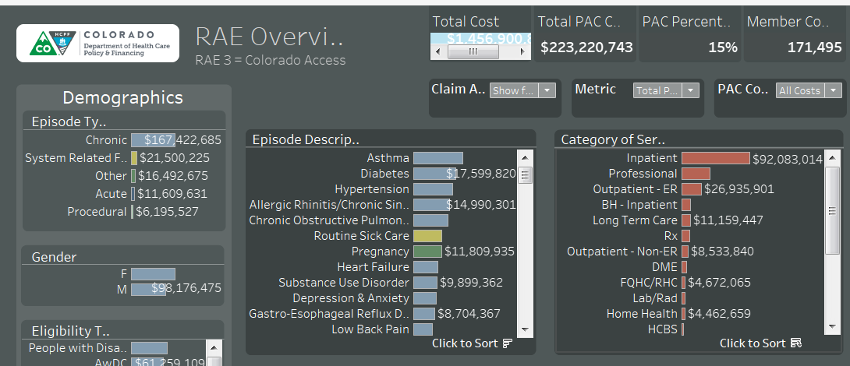
PAC Data Example for RAE 3
In this example from RAE 3, during fiscal years 2017 & 2018 (July 2016-June 2018), asthma, diabetes, and hypertension, have the highest PAC cost episodes. Total episode costs are $1,456,900,000 with PAC totaling 223,220,743 or 15% of all episode costs.
Notes:
***DESCRIBE THE LAYOUT
This slide is an example provided by Altarum and Optumas who produce the PROMETHEUS data. You can see how total cost, PAC cost, member counts, and episodes are included in one dashboard.
In this example from RAE 3, during fiscal years 2017 & 2018 (July 2016-June 2018), asthma, diabetes, and hypertension, have the highest PAC cost episodes. Total episode costs are $1,456,900,000 with PAC totaling 223,220,743 or 15% of all episode costs.
***Note that although SUD appears on this list, that this data has most SUD services scrubbed out due to privacy sharing and contracts in state at the time.
There are also categories of service, of which inpatient, professional fees, and outpatient-ER are the highest PAC costs.
***PRINT SPEC DOC AND USER GUIDE

Slide 7
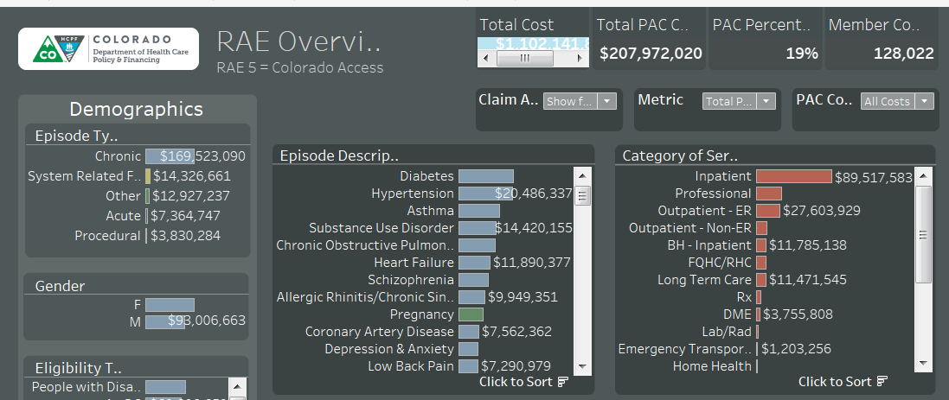
PAC Data Example for RAE 5
In this example from RAE 5, during fiscal years 2017 & 2018 (July 2016-June 2018), diabetes, hypertension, and asthma have the highest PAC cost episodes. Total episode costs are $14,102,141 with PAC totaling 207,972,020 or 19% of all episode costs.
Notes:
***DESCRIBE THE LAYOUT
This slide is an example provided by Altarum and Optumas who produce the PROMETHEUS data. You can see how total cost, PAC cost, member counts, and episodes are included in one dashboard.
In this example from RAE 5, during fiscal years 2017 & 2018 (July 2016-June 2018), diabetes, hypertension, and asthma have the highest PAC cost episodes. Total episode costs are $14,102,141 with PAC totaling 207,972,020 or 19% of all episode costs.
***Note that although SUD appears on this list, that this data has most SUD services scrubbed out due to privacy sharing and contracts in state at the time.
There are also categories of service, of which inpatient, professional fees, and outpatient-ER are the highest PAC costs.

Slide 8
PAC Deliverables for HCPF
Select 3 episodes, including Substance Use Disorder (SUD).
Write a work plan where each of the top PAC episodes are reviewed, analyzed, and compared to the Colorado population as well as nationally recognized research.
Estimate the return on investment (ROI)
Create a timeline with key milestones to address PAC.
Notes:
First, each region must review their PROMETHEUS dashboards and analyze high cost services and episodes. They will ultimately select 3 episodes/diagnoses to address, one of them being Substance Use Disorder (SUD).
Then, each region will write a work plan where each of the top PAC episodes are reviewed and analyzed
Examples of steps within a work plan:
Develop meaningful clinical and system interventions that aim to decrease PAC
Engage partners (i.e. hospitals, clinics, doctors)
Build capacity within the region
Utilize data provided by the State
Since the overall goal of PAC is to reduce costs, each region will estimate the return on investment (ROI) for resources devoted in the project.
To assure this reduction in cost happens, the regions will develop a timeline for completing their work plan. This will include key milestones and clinical interventions that will help address PAC.
In future years, measurement of performance may be tied to a dollar amount or percent increase/decrease.
Ex: Reduce Asthma members utilizing the emergency department for rescue inhalers by X%.
Submitting the work plan and each milestone assures that all incentive dollars are received.

Slide 9
Available Funds and Payment Tiers
Milestone Payment Tiers
Total Score | Payment %
90-100 points | 100%
80-89 points | 75%
0-80 points | 0%
100%
2.7 mil
Notes:
****DESCRIBE THE GRAPH
Again, this is different from other P4P’s that have actual percent increase/decrease %’s
In FY19 the work plan was worth 40% of funds and milestones were 60% - 100% of funds were earned for a total of $2.7 million.
1.9 payable to providers (Q: How was this shared across BH and PH? Krista: OK to share general $ but not sharing model)
276k held for innovations pool
552 retained by COA
TBD for FY20

Slide 10
COA’s FY2019 PAC Work Plan

Slide 11
PAC FY19 Episodes
PEDIATRIC ASTHMA
DIABETES
COPD
Comorbidities
Notes:
The chronic conditions of Asthma & Diabetes were top costs, selected pediatric asthma as children were the highest sub-group and it is one of the few PROMETHEUS episodes that includes members under 18
Chronic Obstructive Pulmonary Disease (COPD) had the opportunity to target a smaller population with challenging symptoms
SUD was not required in FY19, data was not distributed, and stakeholders agreed to not pursue.

Slide 12
FY19 Milestones
Milestone Description | Weight | Due Date
Registry Development | 6.7 | 4/30/2019
2. Ongoing Data Review with Community Partners | 8.0 | 5/31/2019
3. Clinical Workflow and Best Practice Design | 7.3 | 6/14/2019
4. Clinical Intervention Execution | 6.3 | 6/28/19
5. Key Provider Debrief of Work Plan | 5.0 | 6/28/2019

Slide 13

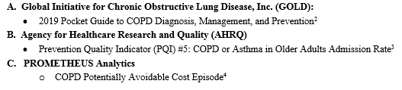
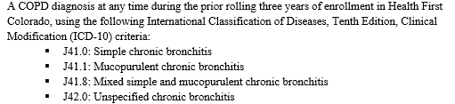
FY19 Milestone 1: Registry & Methodology
Notes:
Clinical registries for asthma and diabetes were updated to include new research and best practices and also risk stratification. Anxiety and depression were included for pediatric asthma and diabetes. For diabetes, hypertension was also included as a comorbid factor. (EXPLAIN RISK STRATIFICATION)
A COPD registry was created also using best practices and current research, risk stratification, and other co-morbidities of interest (depression, anxiety, and hypertension).
After launching the registries, we analyzed the populations for any further insights into a targeted case management practice.
***Print examples of each

Slide 14
FY19 Milestone 3: Care Management
The lifecycle of the Care Management work flow for each of the 3 episodes
Day 1: Introductory Call
Week 1:
Home
Visit
Day 14: Telephonic Outreach
Day 30: Telephonic Outreach
Day 45: Telephonic Outreach
Day 60: Telephonic Outreach
Day 180: Chart Review
Notes:
The lifecycle of the Care Management work flow for each of the 3 episodes
Clinical intervention.
CM’s used EBP’s such as asthma action plans, diabetes education/training…Care plan – internal cross-collaboration, collab with providers…Innovative approaches such as teach-back methods

Slide 15

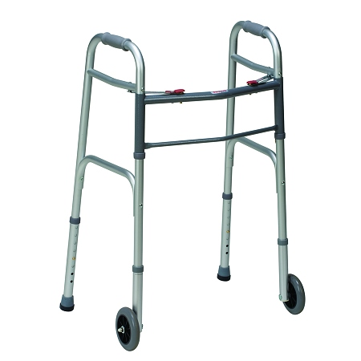

Results of PAC Interventions
Over 100 members outreached in 2 months
A Care Coordinator attended a therapy session with a Member with COPD to help create a care plan with a therapist to find appropriate housing, transportation to medical appointments, coordinate home health nursing care and a cane to help them avoid falls.
For a Member with asthma, a Care Coordinator attended a pulmonology appointment and helped create a care plan that included obtaining a CPAP sterilizer and supplies, starting “Cooking Matters” courses, find a backpack/school supplies for school and follow up with a provider at the Children's Hospital Lifestyles clinic to help him lose weight.
Notes:
A Care Coordinator attended a therapy session with a Member with COPD to help them create a care plan with their therapist to find appropriate housing and transportation to medical appointments as well as to get a an order from their primary care provider for home health nursing care and a cane to help them avoid falls.
For a Member with asthma a Care Coordinator attended his pulmonology appointment and helped him create a care plan with the nurse practitioner to get a CPAP sterilizer and CPAP supplies, start Cooking Matters courses, find a backpack/school supplies for school and follow up with a provider at the Children's Hospital Lifestyles clinic to help him lose weight.

Slide 16
COA’s FY2020 PAC Work Plan

Slide 17
PAC FY20 Episodes
PEDIATRIC ASTHMA
DIABETES
SUD
Notes:
Based on feedback from Stakeholders and PAC data, COA will continue to pursue Asthma and Diabetes
Based on new requirements and the promise of data sharing, SUD will be the third episode for PAC FY19-20.
This year will move from the care management level focus to a systems level focus…
Systems approach
SUD data still pending

Slide 18

PAC FY20 Approach: Diabetes & Asthma
Notes:
As the previous year substantiated a member-level approach through care management and targeted registries, the second year will address Diabetes and Asthma through a systems level approach

Slide 19

PAC FY20 Milestones: Diabetes & Asthma
Milestone Description
1. Inventory of Hospital Systems
Inpatient & Outpatient Partner Regional Convening
3. Hospital System Coordination Plan
4. Evaluation of Intervention
Notes:
Collecting what workflow key components each provider partner has and seeing where they do or don’t line up…
***ECP lists

Slide 20
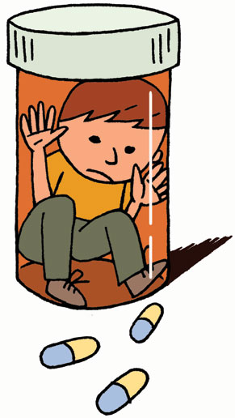
PAC FY20 Work Plan: SUD
  TBD, pending data from the State
Notes:
As mentioned earlier, SUD data is still pending from the State (42 CFR Part 2… contracts…), however, HCPF has shown us a list of what ranking SUD is out of all episodes for each region
RAE 5 – SUD is #1, followed by Asthma and Diabetes
RAE 3 – SUD is also #1, followed by hypertension, diabetes, COPD (Chronic Obstructive Pulmonary Disease), and Asthma
Based on alignment with other SUD priorities in FY20, COA is targeting Medically Assisted Treatment and planning to analyze the PROMETHEUS dashboards and also take an inventory of the current provider network and any gaps in care. COA’s milestones and intervention will most likely focus on increase provider awareness of MAT and their capacity to serve MAT clients with the support of our tele-psychiatry program.

Slide 21
QUESTIONS? FEEDBACK?
Notes:
Kelly can explain the small group discussion.

Slide 22
Discussion Questions
For future report-outs, what would you like to know more about and in what format? (More data? More information about clinical programming interventions?)
Are you aware of programs in the community related to these PAC priorities that Colorado Access should be aware of and learn more about?
What do you think Colorado Access and regional partners can do to have the most impact?
Is there anything you think is missing from this conversation that would make a significant difference?

Slide 23
Policy Changes from the State – A Shift Towards Cost Containment and Reduction
Kelly Marshall
Director of Community Engagement at Colorado Access

Slide 24
Regional PIAC – Contractual Responsibilities
Provide representatives for the statewide PIAC
Review Member materials and provide feedback
Review the Contractor’s (Colorado Access) deliverables
Discuss program policy changes and provide feedback
Review the Contractor’s (Colorado Access) and Program’s performance data
(Base Contract Section 16.9.2, pg. 109-110)

Slide 25
Kim Bimestefer, Executive Director of HCPF
Excerpt from presentation to State PIAC in August

Slide 26
Kim Bimestefer, Executive Director of HCPF
Excerpt from presentation to State PIAC in August

Slide 27
Kim Bimestefer, Executive Director of HCPF
Excerpt from presentation to State PIAC in August

Slide 28
Kim Bimestefer, Executive Director of HCPF
Excerpt from presentation to State PIAC in August

Slide 29
Preparing for Change
New “ACC Performance Pool”
Monies from unearned Physical Health P4P budget
Focus on high cost utilizers and Big 10
Changes RAEs are told to expect:
Changes to several major deliverables and reports due to the State
Changes to the 7 Physical Health Pay for Performance measures (also known as Key Performance Indicators or KPIs)
  By next summer (Year 3 of contract)

Slide 30
ACC Performance Pool – High Cost Utilizers
High Cost Population identified by the State Approximately 53% are attributed to Colorado Access’ Enhanced Clinical Partners (ECPs)
 | Region 3 (%) |  | Region 5 (%) |  | Total
Adults | 5,680 | 68% | 3,503 | 84% | 9,183
Children | 2,678 | 32% | 688 | 16% | 3,366
Total | 8,358 |  | 4,191 |  | 12,549

Slide 31

High Cost Utilizers – Where to Start?
As part of developing the plan to address the high utilizer group, a robust analytics project took place to understand the high utilizer population, including population trends and key sub-groups that could be prime for intervention and cost control.
The following groups were identified, as well as the prioritized clinic systems to engage with in the initial roll out:
High cost adults with co-morbid conditions
Pediatric members with polypharmacy utilization
High cost pediatric members under age 5
Adults with diabetes and polypharmacy utilization
Pediatric members with asthma
Notes:
Extended and Intensified Care Coordination
Percentage of identified population engaged in extended care coordination services (December 2018 – June 2019):
RAE 3 = 21% (1,735 of 8,358)
RAE 5 = 35% (1,467 of 4,191)
Goals:
To increase % of identified population into extended care coordination and close this gap.
To intensify care coordination for hard-to-engage populations and those with high clinical/medical needs.
Work with regional Enhanced Clinical Partners (ECPs)
Deploy adult and pediatric specific strategies and approaches

Slide 32

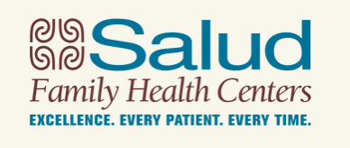
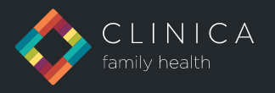
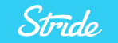
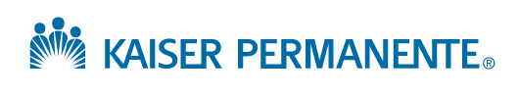
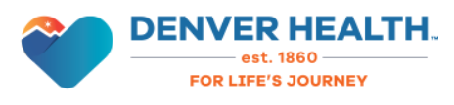
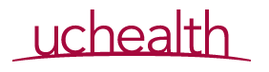
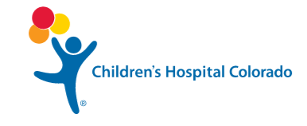
Engaging Our Key Partners…
As part of the analytics work, Colorado Access identified key partners to engage with as part of the initial roll out of work. These top 8 clinic systems account for over 50% of the high utilizer population across Regions 3 and 5.
1,126 members
610 members
497 members
483 members
655 members
1,703 members
1,660
members combined
Colorado Access has set up clinical leadership meetings with each system to further strengthen the robust partnership and set the foundation for ongoing dialogue and joint strategy development.
Notes:
Krista

Slide 33

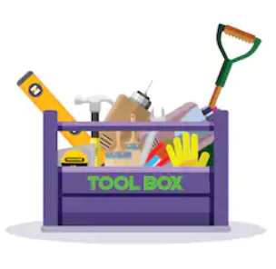

Setting the Region Up for Success…
As part of the program rollout, Colorado Access developed guidance for each clinic based on each clinic’s unique population profile.
This included a customized toolkit and data package with prioritized populations already identified and ready for intervention.
Webinar vignettes providing overviews on the Performance Pool work, toolkit and data packages are made accessible on-demand to the provider community via our website.
Notes:
Krista

Slide 34
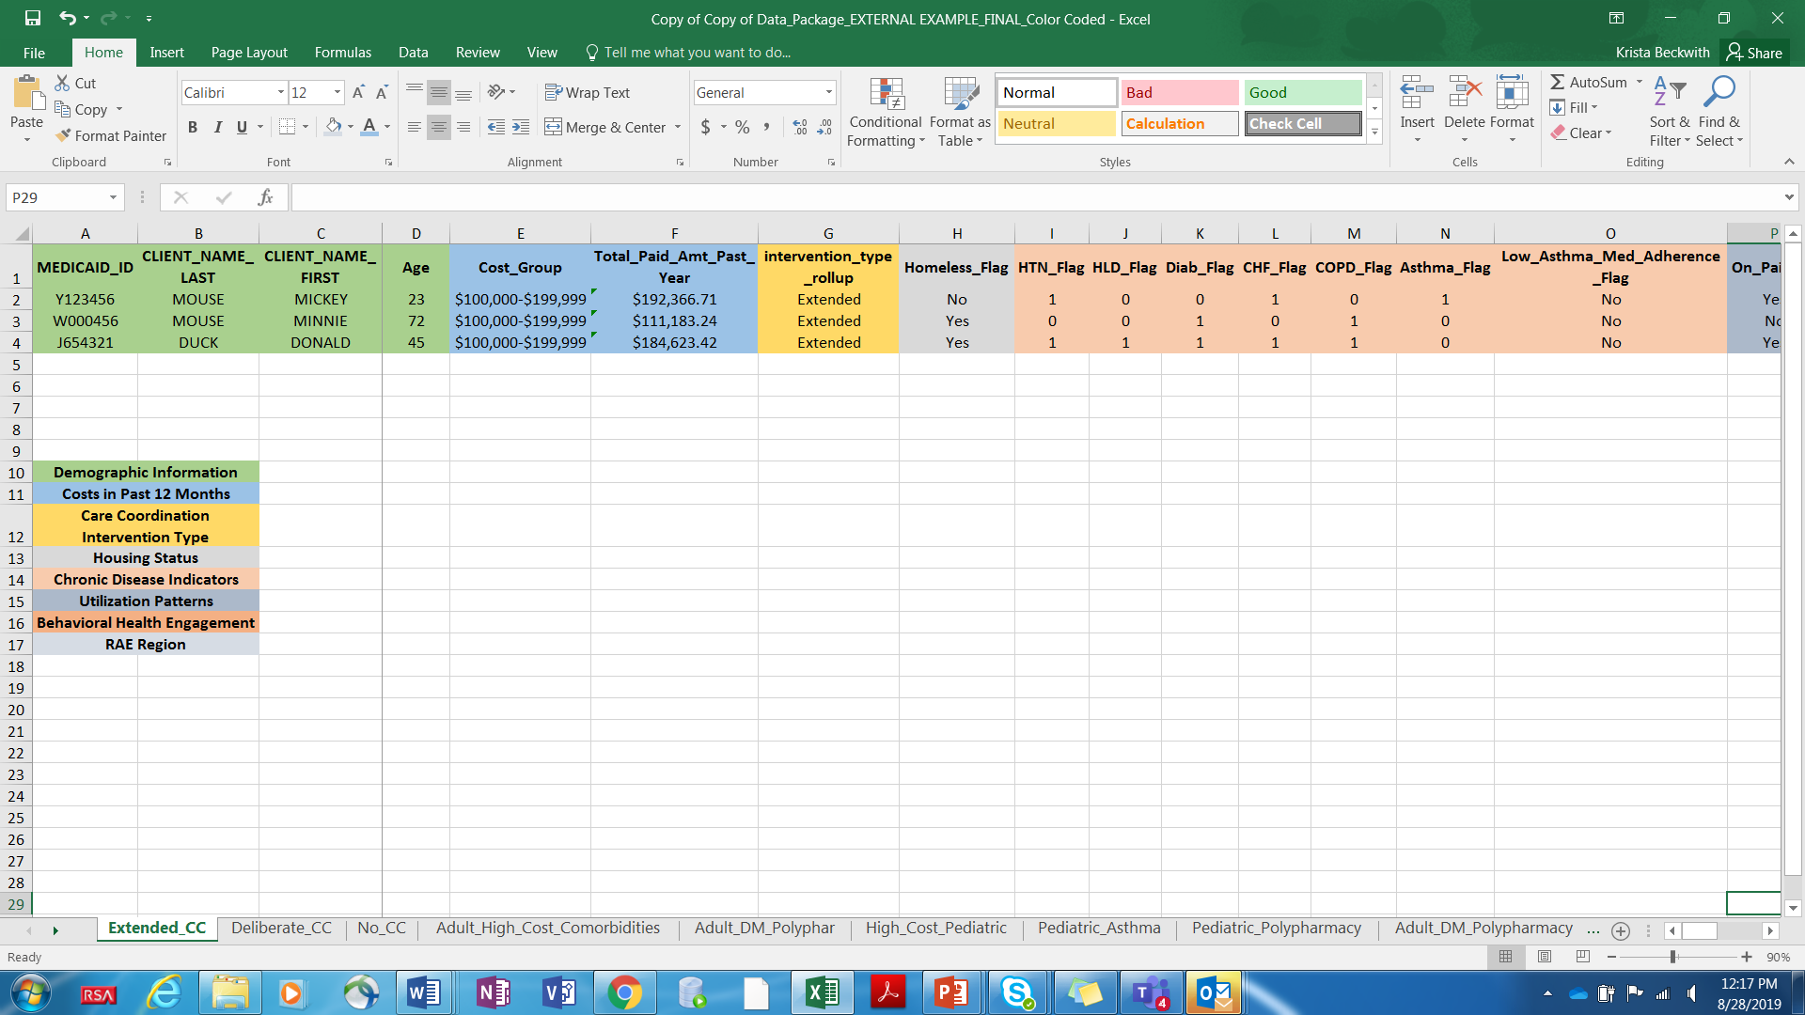
Data Package Example
Notes:
Krista

Slide 35
Fist to Five for Broad-Level Understanding
QUESTIONS?
Notes:
Kelly can explain the small group discussion.

Slide 36
SMALL GROUP DISCUSSION
Notes:
Kelly can explain the small group discussion.

